Slide 1
Title
Design and Development of Brain-Computer Interface (BCI) for Navigating Drone

Slide 2
GROUP MEMBERS
Naneeta
Madiha
M Raheal Safdar
SUPERVISOR: DR. AHSANULLAH ABRO
Co-SUPERVISOR: AHMED ALI SHAH / RIAZ AFRIDI

Slide 3
Background
One out of every five individuals on the planet Earth is according to WHO global report 2011.
Common diseases in disabled persons such as:
amyotrophic lateral sclerosis (ALS),
spinal cord damage
brainstem stroke
conditions that cause voluntary muscle control to be lost.
Those who lack motor skills might benefit greatly from devices that increase movement.

Slide 4
Introduction
Brain Computer Interfaces (BCI)
Electroencephalography (EEG)
EEG Headset (EMOTIV EPOC)
Unmanned Aerial Vehicle (UAV) OR Drone

Slide 5
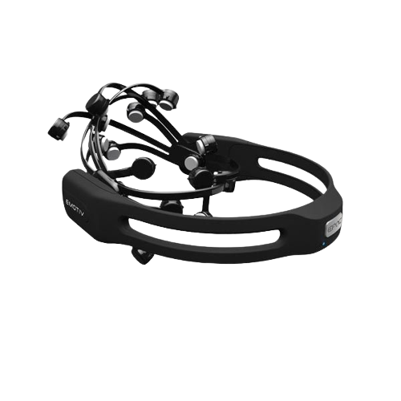
Introduction
EEG Headset (EMOTIV EPOC)

Slide 6
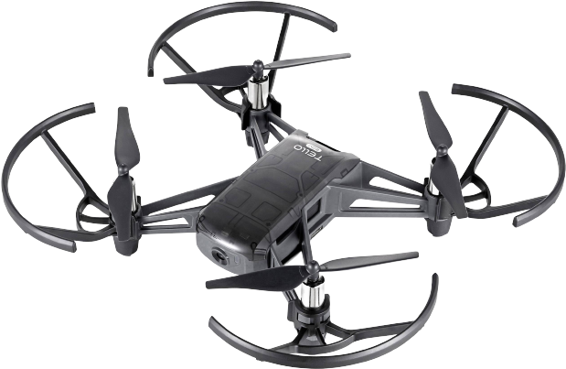
Introduction
Unmanned Aerial Vehicle (UAV) OR Drone

Slide 7
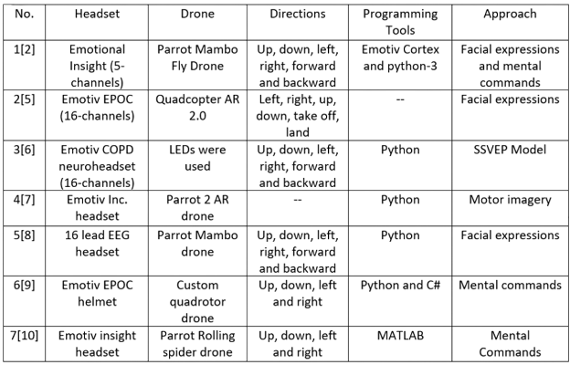
Literature Review

Slide 8
Problem Statement
There is a lack of navigational cues to detect user’s brain signals and to translate them into expected actions and activities accurately to control the navigational cues of drone.

Slide 9
Aim and Objectives
To make people able to control electric devices specifically Drone through Brain signals.
To control Drone movement through mental commands in six specific directions (left, right, forward, backward, takeoff, land).

Slide 10
Significance
With the help of this project disabled people will be able to perform their daily tasks without help of others.

Slide 11
Proposed Methodology
We will prefer the agile methodology for the development of this project.
It is iterative and incremental.
A strong communication and coordination is needed between team and project stakeholders.
Focuses more on development than documentation.

Slide 12
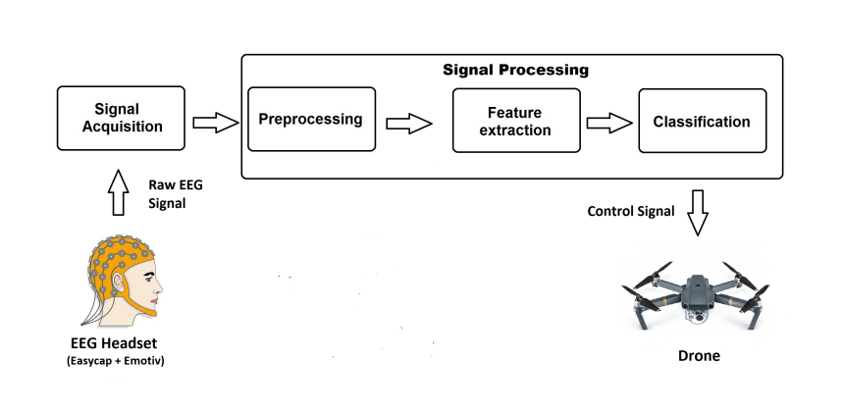
Proposed Application Architecture

Slide 13
Tools and Technology
Tools
PyCharm IDE or Google Collaboratory
Visual Studio
Programming Languages
Python
C#

Slide 14
Expected Outcome
Drone will be controlled with brain signals acquired through EEG device.

Slide 15
Timeline
Activity | 2022 |  |  |  |  |  |  |  |  |  | 2023
 | Mar | April | May | June | July | August | Sep | Oct | Nov | Dec | Jan
Literature Review (LR)
Problem Identification
System Requirements Specification
System Design Specification
System Development
System Testing

Slide 16
THANK YOU
ANY SUGGESTION?

